Slide 1
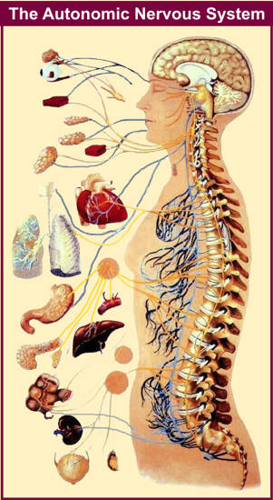
Peripheral autonomic nervous system and pharmacology

Slide 2
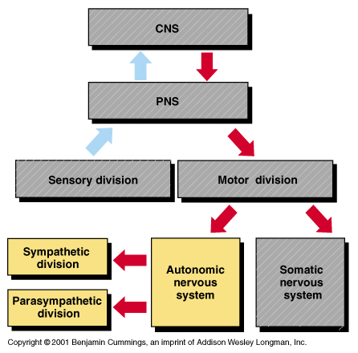
Introduction
Nervous system

Slide 3
Introduction
Anesthesia is the practice of autonomic medicine.
Drugs that produce anesthesia also produce potent autonomic side effects.
The greater part of our training and practice is spent acquiring skills in averting or using
the autonomic nervous system (ANS) side effects of anesthetic drugs under a variety of pathophysiologic conditions.
The success of any anesthetic depends on how well homeostasis is maintained

Slide 4
Cont.….
The nervous system controls all the major function of the body divide in to
central NS
peripheral NS :-
Peripheral NS
ANS (autonomic NS): involuntary function
somatic NS : control voluntary
Central NS
brain and spinal cord

Slide 5
Cont.….
The ANS includes that part of the central and peripheral nervous system concerned with
involuntary regulation of cardiac muscle, smooth muscle, glandular, and visceral functions.
ANS activity refers to visceral reflexes that function below the conscious level.
The ANS is also responsive to changes in somatic motor and sensory activities of the body

Slide 6
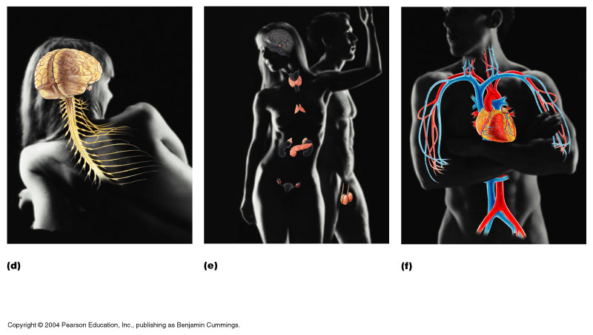
The autonomic nervous system (ANS) is largely autonomous (independent) in that
its activities are not under direct conscious control.

Slide 7
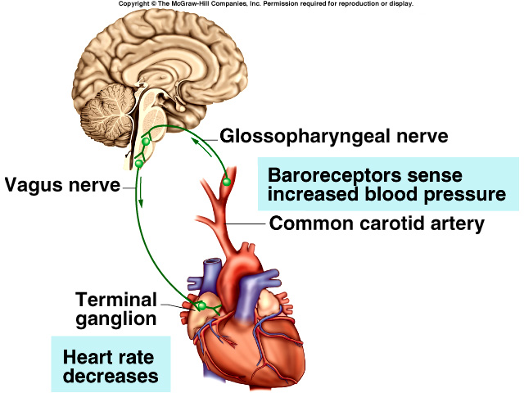
Cont.….
In the periphery, it consists of nerves, ganglia, and plexuses
that innervate the heart, blood vessels, glands, other visceral organs, and smooth muscle in various tissues.
It is concerned primarily with visceral functions such as
cardiac output, blood flow to various organs, and digestion, which are necessary for life.

Slide 8
The somatic division is largely concerned with
consciously controlled functions such as movement, respiration, and posture.

Slide 9
Comparison of Somatic and Autonomic Nervous Systems
Although the anatomy of the somatic and ANS sensory pathways is identical,
the motor pathways are characteristically different.
Somatic NS provides motor fibers to skeletal muscle fibers.
ANS provides motor fibers to
smooth and cardiac muscles and glands.
In Somatic NS, a single (unipolar) motor neuron forms the efferent (motor) pathway from the CNS to effectors.

Slide 10
Cont.….
ANS efferent pathway consists of a two (bipolar) neuron chain:
the preganglionic neuron in the CNS and
postganglionic in a ganglion.
Acetylcholine, the neurotransmitter of somatic neurons is stimulatory to skeletal muscle fibers.
Neurotransmitters released by ANS motor neurons-
acetylcholine and norepinephrine -may cause excitation or inhibition

Slide 11
Cont.….
CNS
Skeletal muscle
Autonomic ganglia
CNS
Smooth muscle, cardiac muscle, glands
Preganglionic neuron
Postganglionic neuron

Slide 12
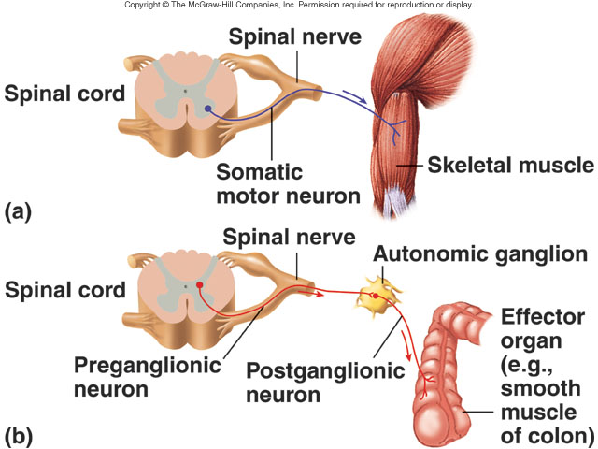

Slide 13
ANATOMY OF THE AUTONOMIC NERVOUS SYSTEM
The peripheral ANS is the efferent (motor) component of the ANS and consists of the same two complementary parts,
the Sympathetic nervous system (SNS) and
the Parasympathetic nervous system (PNS).
Most organs receive fibers from both divisions.
In general, activities of the two systems produce opposite but complementary effects.
A few tissues, such as sweat glands and spleen, are innervated only by SNS fibers.

Slide 14
Cont.….
The ANS lends itself to division on anatomic grounds into two major portion:
sympathetic (thoracolumbar or thoracoabdominal, and
parasympathetic (cranio-sacral) division
Both divisions originate in nuclei within the central nervous system.

Slide 15
The SNS (fight-or-flight system)

Slide 16
Cont.….
Thoracolumbar division (T1-L3)
Activates the body under conditions of emergency
Responses include
dilated pupils (mydriasis),
increased heart and respiratory rates,
↑ Blood Pressure (BP),
dilation of bronchioles,
↑ blood glucose and sweating.

Slide 17
Anatomy of thoraco-lumbar division
The preganglionic fibers of the SNS originate in the intermediolateral gray column of T1- L3 of the spinal cord.
Preganglionic fibers are short and postganglionic fibers are long.
Two types of sympathetic ganglia
paravertebral and prevertebral.
Preganglionic axons leave the cord and enter the paravertebral ganglia (sympathetic chain ganglia) in the sympathetic trunk.

Slide 18
Physiology of SNS
Stimulation of SNS division has two distinctive results:
release of NE at specific locations, and
secretion of E and NE into the general circulation.
Two types of receptors alpha-for NE and E and beta-for E.
Most postganglionic fibers are adrenergic, few cholinergic
With the exception of eccrine sweat glands and some blood vessels,
NE is released by postganglionic sympathetic fibers at end-organ tissues.
In contrast, acetylcholine is released by
preganglionic sympathetic fibers and all parasympathetic fibers.

Slide 19
The PNS (resting-digesting system)
Cranio-sacral division (resting-digesting system).
Conserves body energy and maintains body activities at basal level.
Effects include
pupillary constriction,
increased digestive tract mobility, and
smooth muscle activity leading to defecation and urination.

Slide 20
Anatomy of cranio-sacral division
It also has both preganglionic and postganglionic neurons.
The preganglionic cell bodies originate in
the brainstem and
sacral segments of the spinal cord (S2-S4).
PNS preganglionic fibers are found in cranial nerves
III (oculomotor), VII (facial),
IX (glossopharyngeal), and X (vagus).
The vagus nerve has the most extensive distribution of all the PNS, accounting for more than 75% of PNS activity.
It supplies the heart, tracheobronchial tree, liver, spleen, kidney, and the entire GIT except the distal colon.

Slide 21
Parasympathetic Division
Long preganglionic axon
Short postganglionic axon
Effector organ
Ach Nicotinic
receptor
excitatory
Ach Muscarinic
receptor
excitatory or inhibitory

Slide 22
Physiology of PS division
All parasympathetic preganglionic and postganglionic fibers release Ach at synapses and neuro-effector junctions.
The effects are short-lived because of the actions of cholinesterase.
Stimulation of muscarinic receptors produces a longer lasting effect than does stimulation of nicotinic receptors.
The effects produced by the PS division center on relaxation, food processing and energy absorption

Slide 23
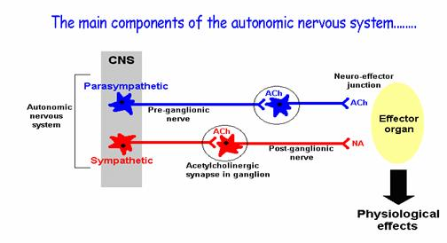

Slide 24
NEUROTRANSMITTER CHEMISTRY OF THE AUTONOMIC NERVOUS SYSTEM

Slide 25
Cont.…
An important classification of autonomic nerves is based on
the primary transmitter molecules:
acetylcholine or norepinephrine (noradrenaline)
A large number of peripheral ANS fibers synthesize and release ACh;
they are cholinergic fibers, i.e., they act by releasing ACh.
Most postganglionic sympathetic fibers release norepinephrine
They are noradrenergic (often called simply "adrenergic") fibers;
they act by releasing norepinephrine.

Slide 26
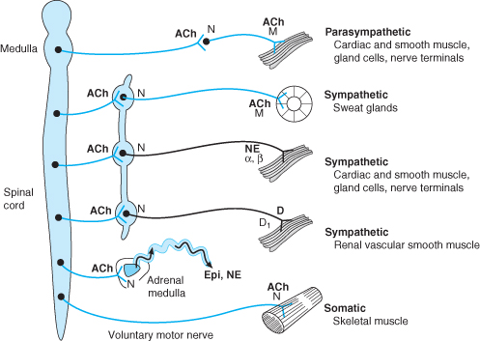

Slide 27
Cont.…
Five key features of neurotransmitter function provide potential targets for pharmacologic therapy:
synthesis,
storage,
release, and
termination of action of the transmitter, and
functions of the receptor.

Slide 28
Cholinergic Transmission
Synthesis of ACh
ACh is synthesized in the cytoplasm from acetyl-CoA and choline through the catalytic action of the enzyme choline acetyltransferase (ChAT).
Acetyl-CoA is synthesized in mitochondria.
Choline is transported from the extracellular fluid into the neuron terminal by a sodium-dependent membrane choline transporter.
This transporter can be blocked by a group of research drugs called hemicholiniums.

Slide 29
Cont.….
Once synthesized, Ach is transported from
the cytoplasm into the vesicles by a vesicle-associated transporter (VAT).
This transporter can be blocked by the research drug vesamicol.

Slide 31
Cont..
B. Storage of acetylcholine
It is accomplished by the packaging of "quanta" of acetylcholine molecules
(usually 1000-50,000 molecules in each vesicle).

Slide 32
Cont..
C. Release of acetylcholine
Release of transmitter from the vesicles is dependent on extracellular calcium.
The acetylcholine vesicle release process is blocked by botulinum toxin through the enzymatic removal of two amino acids from one or more of fusion proteins.
After release from the presynaptic terminal,
acetylcholine molecules may bind to and activate an acetylcholine receptor (cholinoceptor).

Slide 33
Cont..
D. Inactivation of acetylcholine
Eventually (and usually very rapidly), all of the acetylcholine released diffuses
within range of an acetylcholinesterase (AChE) molecule.
AChE very efficiently splits acetylcholine into choline and acetate, and thereby terminates the action of the transmitter.

Slide 34
Cont..
Most cholinergic synapses are richly supplied with acetyl cholinesterase;
the half-life of acetylcholine in the synapse is therefore very short (seconds).
Acetyl cholinesterase is also found in other tissues:
Red blood cells
Butyrylcholinesterase (pseudocholinesterase), is found in blood plasma, liver, glia, and many other tissues.

Slide 36
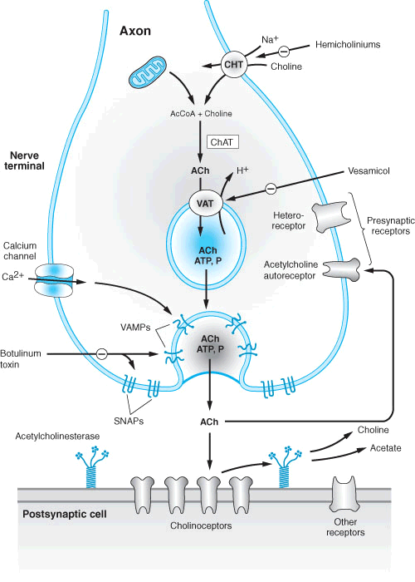
Notes:
Schematic illustration of a generalized cholinergic junction (not to scale). Choline is transported into the presynaptic nerve terminal by a sodium-dependent choline transporter (CHT). This transporter can be inhibited by hemicholinium drugs. In the cytoplasm, acetylcholine is synthesized from choline and acetyl Co-A (AcCoA) by the enzyme choline acetyltransferase (ChAT). ACh is then transported into the storage vesicle by a second carrier, the vesicle-associated transporter (VAT), which can be inhibited by vesamicol. Peptides (P), adenosine triphosphate (ATP), and proteoglycan are also stored in the vesicle. Release of transmitter occurs when voltage-sensitive calcium channels in the terminal membrane are opened, allowing an influx of calcium. The resulting increase in intracellular calcium causes fusion of vesicles with the surface membrane and exocytotic expulsion of ACh and cotransmitters into the junctional cleft (see text). This step can be blocked by botulinum toxin. Acetylcholine's action is terminated by metabolism by the enzyme acetylcholinesterase. Receptors on the presynaptic nerve ending regulate transmitter release. (SNAPs, synaptosome-associated proteins; VAMPs, vesicle-associated membrane proteins.)

Slide 37

Ca²⁺
Na⁺
Muscarinic
Receptor
ACH
Choline
Acetyltransferase
Acetylcholinesterase
Acetyl CoA
+
Acetylcholine
Action Potential
Choline
α
Na⁺
H⁺
β
ACH
Nicotinic
Receptor
Choline
Acetate
α
Choline
Presynaptic neuron
Postsynaptic target

Slide 38
Adrenergic Transmission
Synthesis of catecholamines
The synthesis of the catecholamine transmitters is more complex than that of ACh.
Norepinephrine is synthesized in the cytoplasm of sympathetic postganglionic nerve endings and stored in the vesicles .
Tyrosine in the blood stream is taken up into nerves and converted into catecholamine.

Slide 39
Cont.…
The main enzymes which are critical to the formation of catecholamines are:
a. Tyrosine hydroxylase (tyrosine to dopa)
It is the rate-limiting step in NE synthesis and is located in the cytoplasm.
inhibited by metyrosine (a-methyl-p-tyrosine).
b. Dopa decarboxylase (dopa to dopamine)
found in the cytoplasm of many nonneural and neural tissues.
It had been called "aromatic-L-amino acid decarboxylase" because of its broad substrate specificity.
Peripheral (non-neuronal) dopa decarboxylase can be inhibited by carbidopa.

Slide 40
Cont.…
c. Dopamine-ß- hydroxylase (dopamine to norepinephrine)
is a copper-containing enzyme located primarily within the membrane of amine storage granules.
d. Phenyl ethanolamine-N- methyl transferase (norepinephrine to epinephrine)
It is restricted to the adrenal medulla, the brain, with only trace amounts in other locations.
strongly inhibited by physiological concentrations of epinephrine.
Glucocorticoid increases enzyme activity.

Slide 41
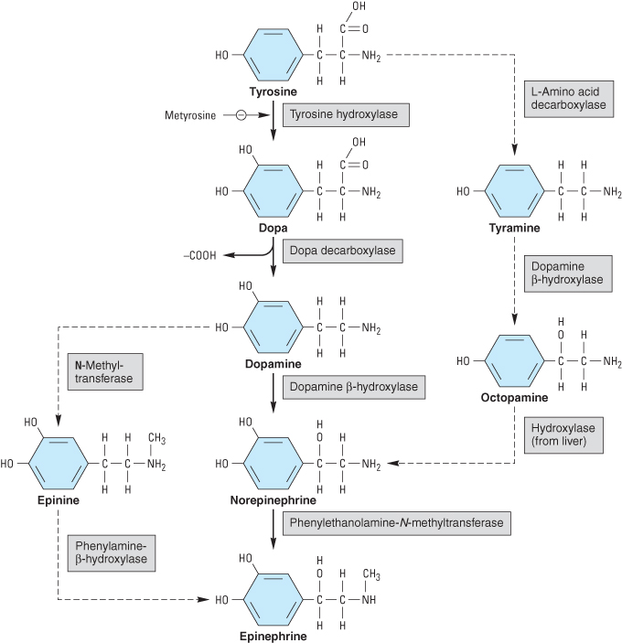
Notes:
Biosynthesis of catecholamines. The rate-limiting step, conversion of tyrosine to dopa, can be inhibited by metyrosine ( -methyltyrosine). The alternative pathways shown by the dashed arrows have not been found to be of physiologic significance in humans. However, tyramine and octopamine may accumulate in patients treated with monoamine oxidase inhibitors.

Slide 42
Cont.…
B. Storage
Vesicles store NE and protect it from breakdown by monoamine oxidase (MAO) in the surrounding cytoplasm.
These vesicles are subsequently transported to the neuron terminal region for release.
A high-affinity carrier for catecholamines located in the wall of the storage vesicle (vesicular monoamine transporter, VMAT)
Can be inhibited by the reserpine alkaloids.
Reserpine causes depletion of transmitter stores.

Slide 43
Cont.…
C. Release
Occurs when ACh liberated from preganglionic neurons induces depolarization of postganglionic sympathetic neurons by acting on a nicotinic receptor.
Release of the vesicular transmitter store from noradrenergic nerve endings is calcium-dependent process.

Slide 44
Cont.…
D. Inactivation (Termination)
Released catecholamines may be:
i) retaken up into the neuron
(norepinephrine transporter or uptake I),
ii) taken up by the extraneuronal tissue
(uptake II), or
iii) washed into the extracellular fluid
and ultimately into the circulation.

Slide 45
Cont.…
Norepinephrine is synthesized in the cytoplasm of sympathetic postganglionic nerve endings and stored in the vesicles .
After release by a process of exocytosis, the action of norepinephrine is primarily terminated by
reuptake into the postganglionic nerve endings (inhibited by tricyclic antidepressants), but also
by diffusion from receptor sites, or
via metabolism by monoamine oxidase (inhibited by monoamine oxidase inhibitors) and
via metabolism by catechol- O -methyltransferase

Slide 46
Autonomic Receptors
Acetylcholine receptors
Adrenoreceptors

Slide 47
1. Acetylcholine (Cholinergic) receptors
There are two major classes of acetylcholine receptor:
nicotinic and
muscarinic.
Peripheral visceral organ is typically muscarinic.
The parasympathetic ganglia as well as responses of skeletal muscle are nicotinic.

Slide 48
Nicotinic receptors
Nicotinic Receptors - so-called because the effects of nicotine in ganglia and on skeletal muscle mimic the actions of ACh.
Nicotinic receptors fall into three main classes:
the muscle,
ganglionic and
CNS types;
They are typical of ligand-gated ion channels.

Slide 49
Muscarinic receptors (M₁, M₂, M₃₎
M₁-receptors ('neural') are found mainly on:
CNS neurons
peripheral neurons and
gastric parietal cells
Deficiency of this kind of acetylcholine-mediated effect in the brain is possibly associated with dementia.
M₁-receptors are also involved in the increase of gastric acid secretion following vagal stimulation.

Slide 50
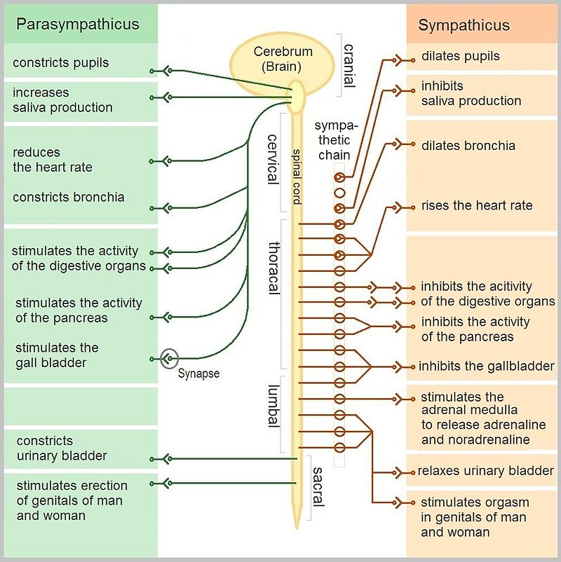

Slide 51
Cont..
M₂-receptors ('cardiac') occur in the heart, and also on the presynaptic terminals of peripheral and central neurons.
M₂-receptor activation is responsible for the:
vagal inhibition of the heart
presynaptic inhibition in the CNS and periphery

Slide 52
Cont..
M₃-receptors ('glandular/smooth muscle')
stimulation of glandular secretions (salivary, bronchial, sweat, etc.) and
contraction of visceral smooth muscle.

Slide 53
2. Adrenoreceptors (Adrenergic receptors)
The term “adrenergic” originally referred to the effects of epinephrine ( adrenaline),
although norepinephrine (noradrenaline) is the primary neurotransmitter responsible
for most of the adrenergic activity of the SNS
Notes:
With the exception of eccrine sweat glands and some blood vessels, norepinephrine is released by postganglionic sympathetic fibers at end-organ tissues

Slide 54
Cont.…
Adrenergic receptors are divided into two categories: α and β.
α-adrenoceptor
α₁
α₂
β-adrenoceptor
β₁,
β₂ and
β₃
III. Dopamine (DA)-receptor types
Notes:
Adrenergic receptors are divided into two general categories: α and β. Each of these has been further subdivided into at least two subtypes: α 1 and α 2 , and β 1 , β 2 , and β 3 .
Based on agonist potencies:
α: noradrenaline > adrenaline > isoprenaline
β: isoprenaline > adrenaline > noradrenaline

Slide 55
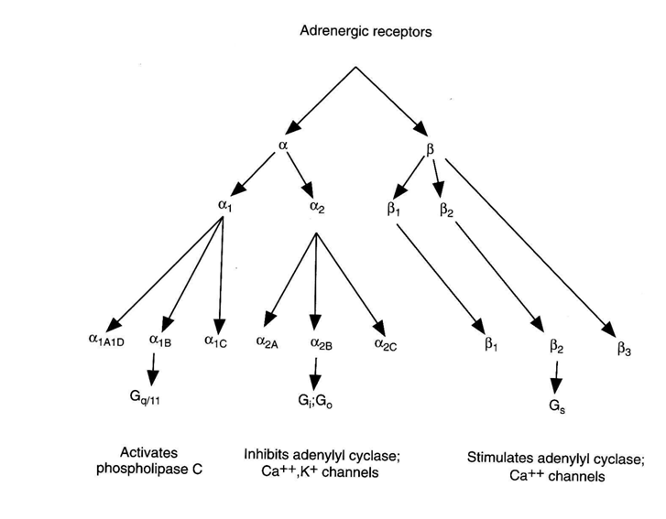
Cont..

Slide 56
α₁ -aderenoceptors
They are postsynaptic adrenoceptors
located in smooth muscle throughout the body
(in the eye, lung, blood vessels, uterus, gut, and genitourinary system).
They increases intracellular Ca²⁺ concentration which leads to smooth muscle contraction.

Slide 57
α₁ –Receptors…
Effects
Mydriasis (pupillary dilation due to contraction of the radial eye muscles),
Vasoconstriction, uterine contracture, and contraction of sphincters in the GI and GUT
inhibits insulin secretion and lipolysis.
The most important cardiovascular effect of α 1 - stimulation
vasoconstriction, which increases PVR, left ventricular afterload, and arterial blood pressure.
Notes:
The myocardium possesses α 1 –receptors that have a positive inotropic effect, which might play a role in catecholamine-induced arrhythmia.

Slide 58
a2-receptors
Located primarily on the presynaptic nerve terminals.
which limits subsequent exocytosis of storage vesicles containing NE
Thus, α2 -receptors create a negative feedback loop that inhibits further NE release from the neuron.
This decreases the entry of calcium ions into the neuronal terminal
Activation of these adrenoceptors inhibits adenylate cyclase

Slide 59

a2-receptors
causes sedation and reduces sympathetic outflow,
Stimulation of postsynaptic a2-receptors in the CNS
which leads to peripheral vasodilation and lower BP
a2 receptors also stimulate platelet aggregation

Slide 60
β₁-Receptors
Located on postsynaptic membranes in the heart.
⇒ which converts ATP to CAMP and initiates a kinase phosphorylation cascade.
Stimulation of β1-Receptors activates adenylate cyclase,
Initiation of the cascade has
positive chronotropic (increased heart rate),
positive dromotropic (increased conduction), and
positive inotropic (increased contractility) effects
Gut smooth muscle relaxation
Lipolysis

Slide 61
β₂-aderenoceptors
Primarily postsynaptic adrenoceptors
located in smooth muscle and gland cells.
They share a common mechanism of action with β₁-receptors
adenylate cyclase activation.
Despite this commonality, β₂ stimulation relaxes smooth muscle, resulting in
bronchodilation, vasodilation, and relaxation of the uterus (tocolysis), bladder, and gut.
Glycogenolysis, lipolysis, gluconeogenesis, and
increase insulin release
Activate the sodium–potassium pump,
which drives potassium intracellularly and can induce hypokalemia and dysrhythmias.

Slide 62
β₃-Receptors
Found in the gallbladder and in brain adipose tissue.
Their role in gallbladder physiology is unknown,
but they are thought to play a role in lipolysis and thermogenesis in brown fat.

Slide 63
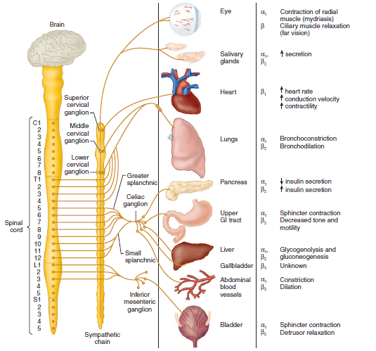
Figure. The SNS organ innervation, receptor type, and response to stimulation.

Slide 64
Dopaminergic Receptors
Dopamine (DA) receptors are a group of adrenergic receptors that are activated by dopamine.
These receptors are classified as D1 and D2 receptors.
Activation of D1 receptors mediates vasodilation in the kidney, intestine, and heart.
D2 receptors are believed to play a role in the antiemetic action of droperidol.

Slide 65
Thank you

